Slide 1

Proposal on
Sentiment analysis for Stock Prediction
Sentimetrics AI
Sulav Timalsina (022-380)
Sushant Poudel (022-387)
Sushil Upadhyay (022-382)

Slide 2
CONTENTS
Background
Literature Review
System Design
Implementation and Discussion

Slide 3
BACKGROUND
The Sentimetrics AI project investigates the connection between public sentiment in news and stock price fluctuations for companies listed on the NEPSE (Nepal Stock Exchange) while also making price predictions.

Slide 4
Problem statement
Scarcity of advanced sentiment analysis and extensive AI usage in prediction of NEPSE market.

Slide 5
Objectives
Analyze public sentiment in inews and perform fundamental analysis to correlate with stock price fluctuations for predictive insights.
Specific Objectives
  Create a methodology for fetching and categorizing news articles about NEPSE firms
  Analyze sentiments of news articles to identify metrics and measure their effects on stock price.
  Create baseline price predictions through historical data and linear regression.
  Adjust predictions by weighing news sentiments and reliability of the media.
  Create an interactive user dashboard to visualize predictions, metrics, and sentiment weights

Slide 6
Scope and Applications
The system focuses on NEPSE listed shares and recognizes news in both English and Nepali. Applications are as follows:
  • Helping investors make informed decisions to buy/sell.
  • Helping analysts investigate the correlation between sentiment and price.
  • Helping portfolio managers assess risk.
  • Helping researchers build upon in the area of financial analytics in emerging markets.

Slide 7
Literature Review
Traditional models like ARIMA and VAR fail to consider non-linear market factors like sentiment, limiting their predictive accuracy in volatile markets such as NEPSE [1][2].
Sentiment analysis captures public emotions from news and social media, offering critical insights for short-term stock price movements in emerging markets [3][4][5].
VADER is efficient for financial text, but struggles with domain-specific terms; Sentimetrics AI enhances it with translation and media credibility weighting [5].
Deep learning models (e.g., LSTM) outperform classical methods but require large data; Sentimetrics AI uses linear regression + sentiment for balance and feasibility [6][7].
Multilingual sentiment analysis is key for NEPSE; translating Nepali/English news into English ensures consistent scoring and leverages insights from low-efficiency markets [8][9].

Slide 8
Literature Review
  Relevance of Sentiment Analysis in Financial Markets
  Influence of Public Sentiment on Stock Prices
  Challenges of Interpreting Sentiment in Financial Text
  Sentiment Analysis vs. Traditional Financial Indicators
  Sentiment Analysis in Financial Markets

Slide 9
System Design
This section outlines the architecture and components of the proposed system.

Slide 10
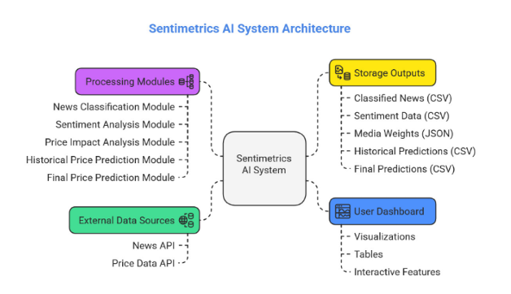
System Architecture

Slide 11
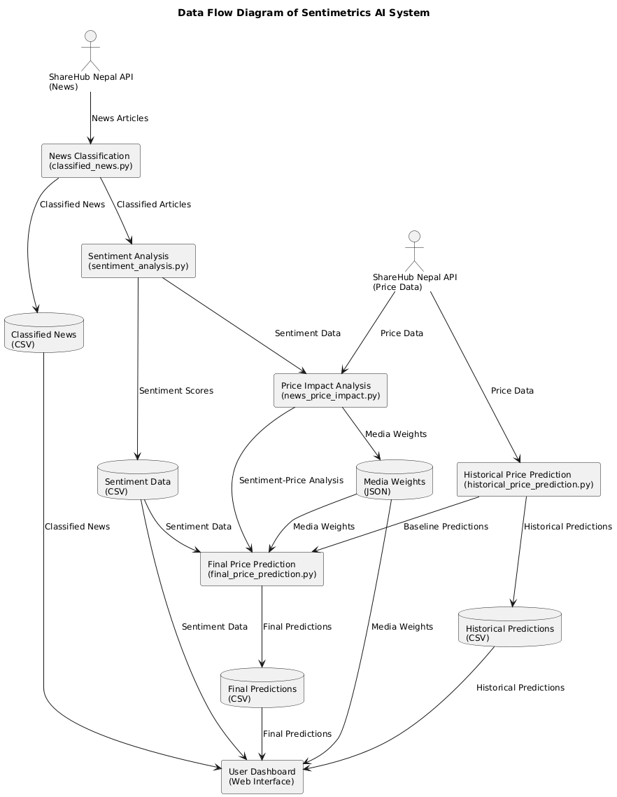

Slide 12
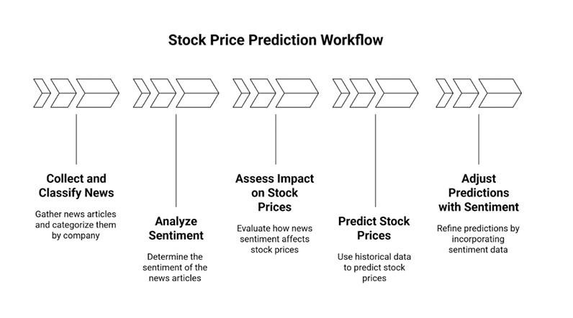
Methodology

Slide 13
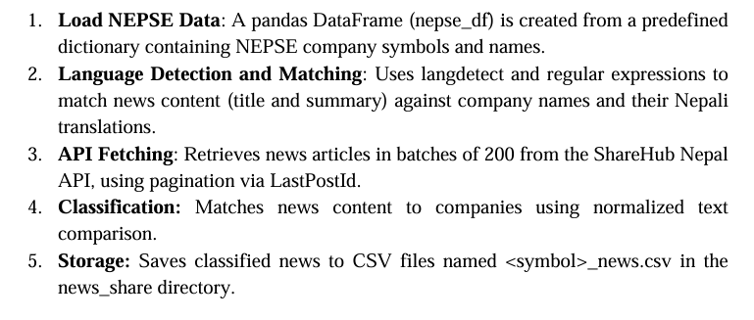
News Collection and Classification

Slide 14
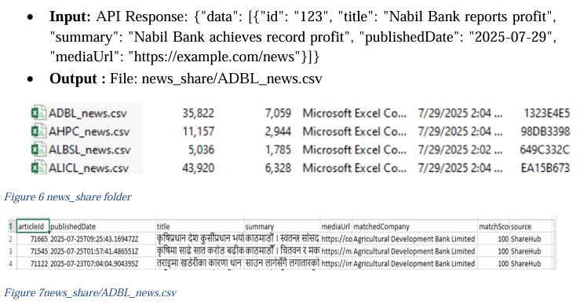
News Collection and Classification

Slide 15
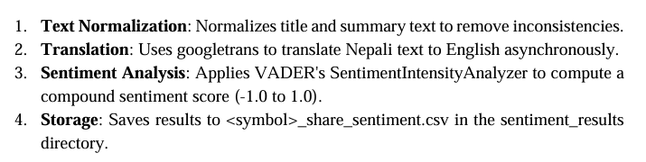
Sentiment Analysis

Slide 16
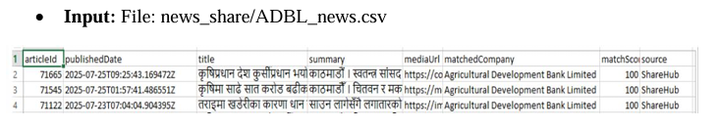
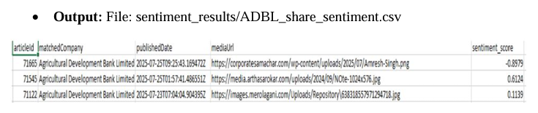
Sentiment Analysis

Slide 17
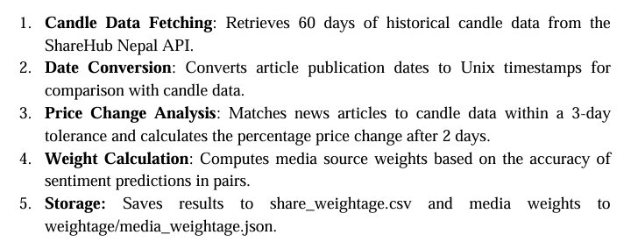
News Price Impact Analysis

Slide 18
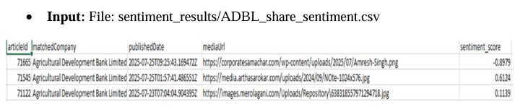
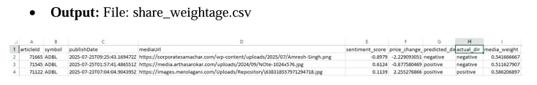
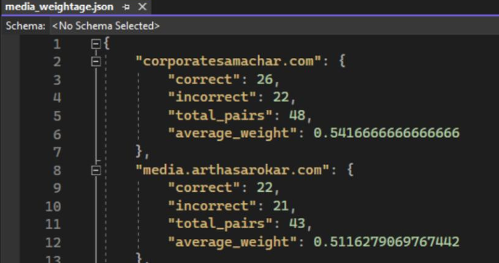
News Price Impact Analysis

Slide 19



News Price Impact Analysis

Slide 20
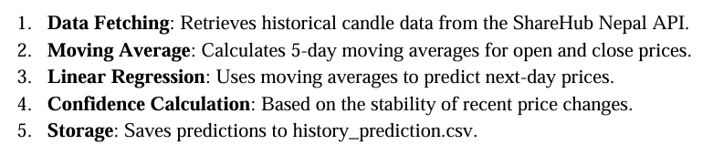
Historical Price Prediction

Slide 21
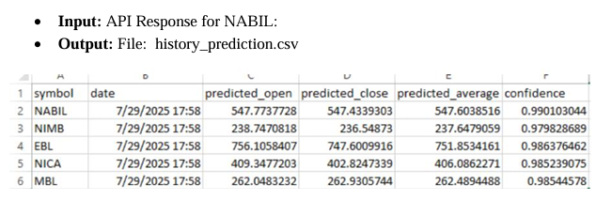
Historical Price Prediction

Slide 22



Historical Price Prediction

Slide 23
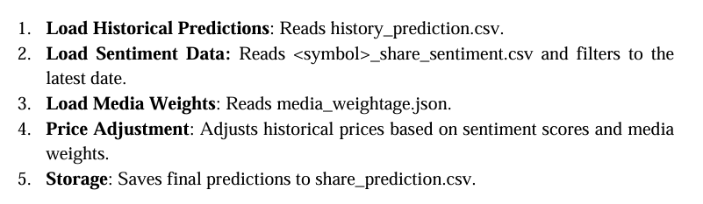
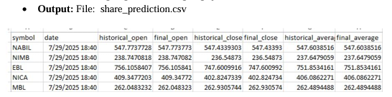
Final Price Prediction

Slide 24
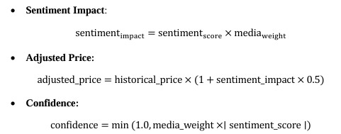
Final Price Prediction

Slide 25
Implementation and Discussion
This section highlights how the project is implemented after detailed methodology was drawn

Slide 26
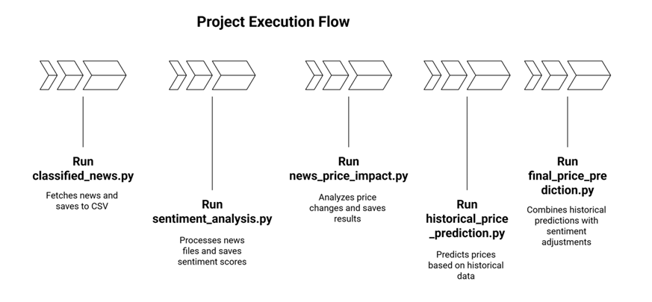
Implementation and Discussion

Slide 27
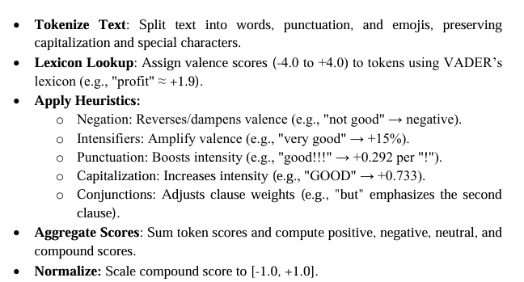
Approach to Classify Sentiment

Slide 28
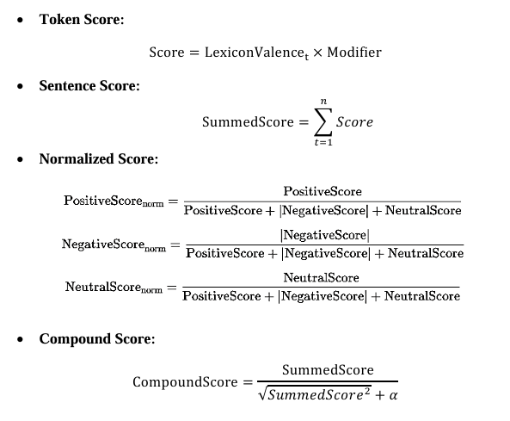
Approach to Classify Sentiment

Slide 29
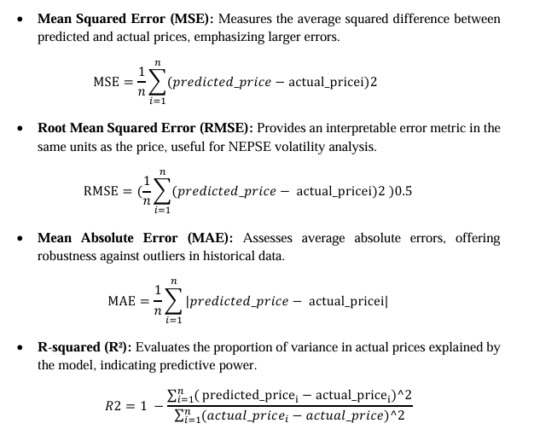
Metrics to Assess Model Performance

Slide 30
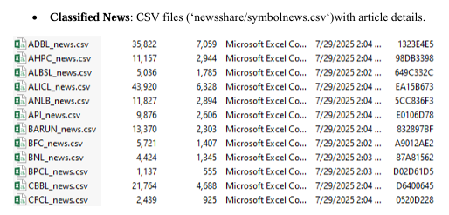
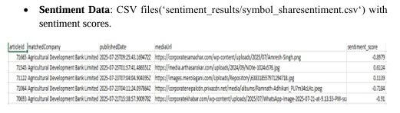
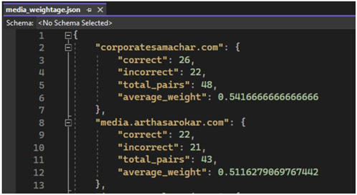
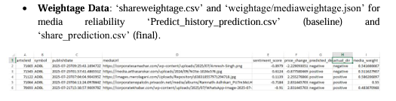
Output Obtained

Slide 31
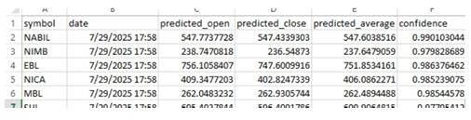
Output Obtained

Slide 32
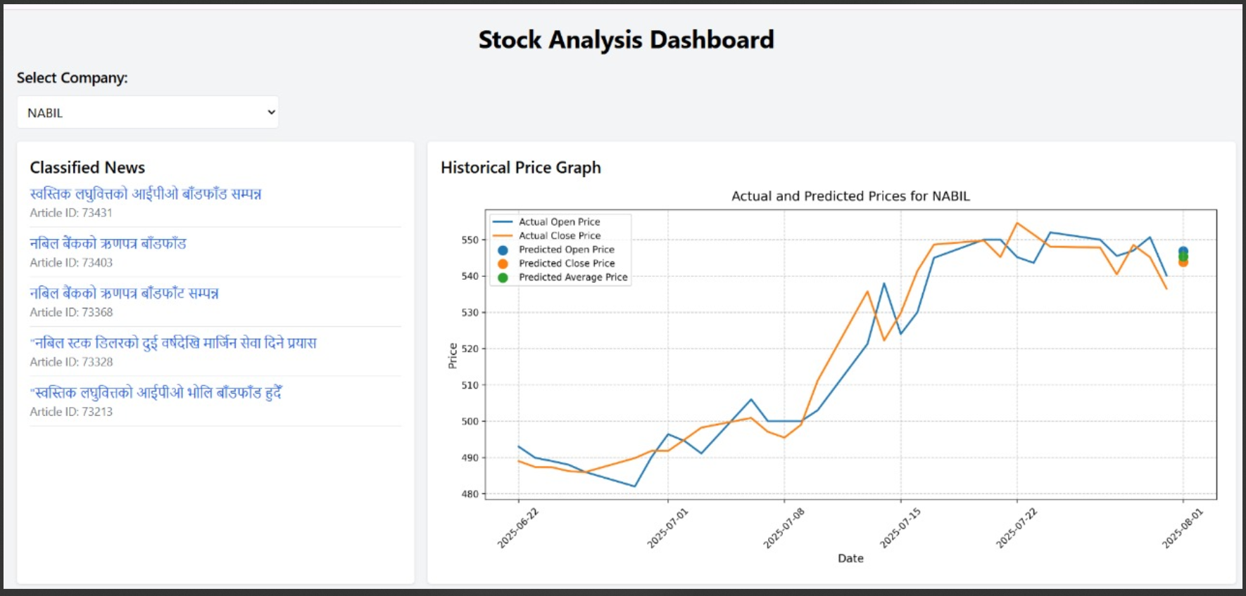
Output Obtained

Slide 33
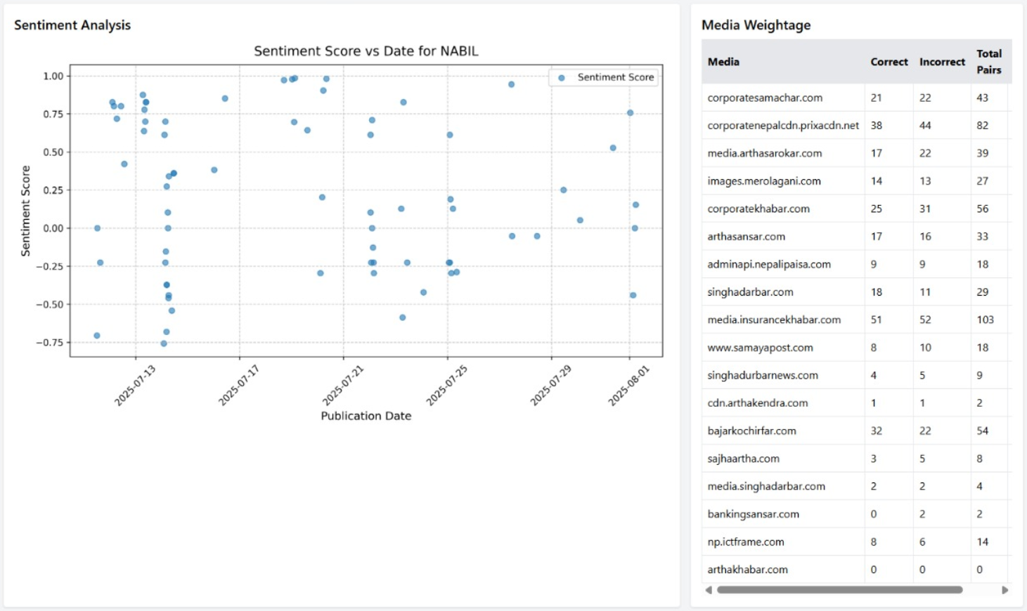
Output Obtained

Slide 34
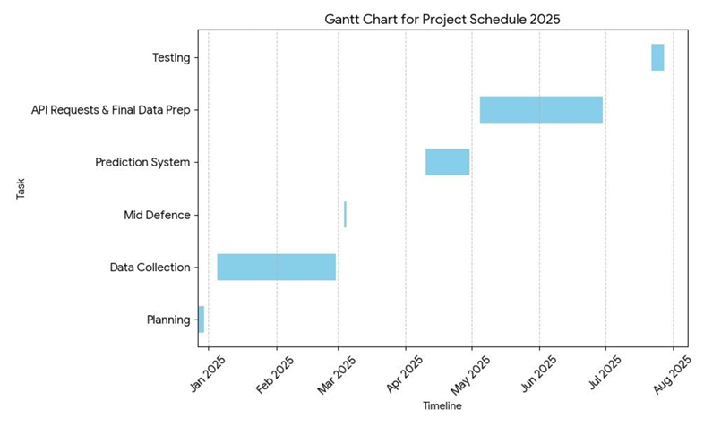
Gantt chart

Slide 35
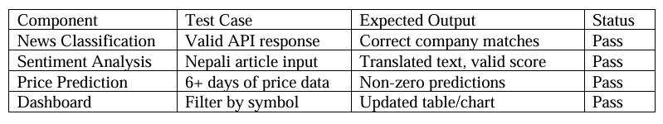
Testing/Test Cases

Slide 36
References
[1] G. E. P. Box, G. M. Jenkins, G. C. Reinsel, and G. M. Ljung, _Time Series Analysis: Forecasting and Control_, 5th ed. Wiley, 2015.
[2] J. D. Hamilton, _Time Series Analysis_. Princeton University Press, 1994.
[3] R. P. Schumaker and H. Chen, “Textual analysis of stock market prediction using breaking financial news: The AZFin text system,” _ACM Trans. Inf. Syst._, vol. 27, no. 2, pp. 1–19, 2009.
[4] X. Li, H. Xie, L. Chen, J. Wang, and X. Deng, “News impact on stock price return via sentiment analysis,” _Knowledge-Based Syst._, vol. 69, pp. 14–23, 2014.
[5] C. J. Hutto and E. Gilbert, “VADER: A parsimonious rule-based model for sentiment analysis of social media text,” in _Proc. 8th Int. AAAI Conf. Weblogs Social Media_, 2014, pp. 216–225.
[6] B. Liu, _Sentiment Analysis: Mining Opinions, Sentiments, and Emotions_. Cambridge University Press, 2015.
[7] X. Ding, Y. Zhang, T. Liu, and J. Duan, “Deep learning for event-driven stock prediction,” in _Proc. 24th Int. Joint Conf. Artif. Intell._, 2015, pp. 2327–2333.
[8] A. Balahur and M. Turchi, “Comparative experiments for multilingual sentiment analysis,” _J. Artif. Intell. Res._, vol. 49, pp. 345–367, 2014.
[9] S. Nam and J. Kim, “Stock price prediction using LSTM and sentiment analysis,” in _Proc. IEEE Int. Conf. Big Data_, 2019, pp. 3170–3175.
[10] S. R. Das and M. Y. Chen, “Sentiment analysis in financial markets: Evidence from Indian stock markets,” _J. Financ. Data Sci._, vol. 1, no. 2, pp. 45–60, 2014.
[11] B. K. Sharma, “Stock price volatility in Nepal Stock Exchange: A statistical analysis,” J. Nepal Financ. Stud. _, vol. 10, no. 1, pp. 23–34, 2020.
[12] K. Thapa, “Market efficiency and news impact in the Nepal Stock Exchange,” _Econ. J. Nepal_, vol. 12, no. 3, pp. 15–28, 2021.

Slide 37
THANK YOU
Sentimetrics AI
Sulav Timalsina (022-380)
Sushant Poudel (022-387)
Sushil Upadhyay (022-382)

